Slide 1
COMM 2293:
Business Communications
Section F
Prof. Emily Ballantyne
March 5 2019 – Reports: APA & Paraphrase

Slide 2
Revise this terrible report. Focus on the memo format, references, feasibility, and signal phrases.
TO: arjun.patel@harvest.ca
FROM: emily.ballantyne@harvest.ca
DATE: 03/05/19
Subject: The Future of Harvest is Fake Meat
…
Trend 2: Sell Cellular Agriculture Products
Another growing trend is selling meat that is grown in a lab. University of Toronto researchers are looking to grow cell-based meat, which is a first in Canada. Cellular agriculture has been touted as the future of food thanks to its smaller environmental footprint and consideration for animal welfare says Canadian Grocer 02/21/19. At this time, no meat is ready to be sold. However, many organizations are working to engineer cellular agriculture products. If Harvest invests in this research, then we might be the first grocery store to stock this in Canada.
References
http://www.canadiangrocer.com/top-stories/headlines/is-canadian-lab-made-meat-headed-to-your-plate-85775

Slide 3
Agenda
APA
Paraphrasing
Parallel Structure

Slide 4
Citation
A citation is an acknowledgment that you used someone else’s ideas
It takes the form of a reference, both in the body of the text and in a separate, complete list

Slide 5
What is the purpose of a citation?
To give credit to others work
To establish your credibility
To show your connection to a field of knowledge or knowledge community
To avoid plagiarism
To help readers find more information
To find references again

Slide 6
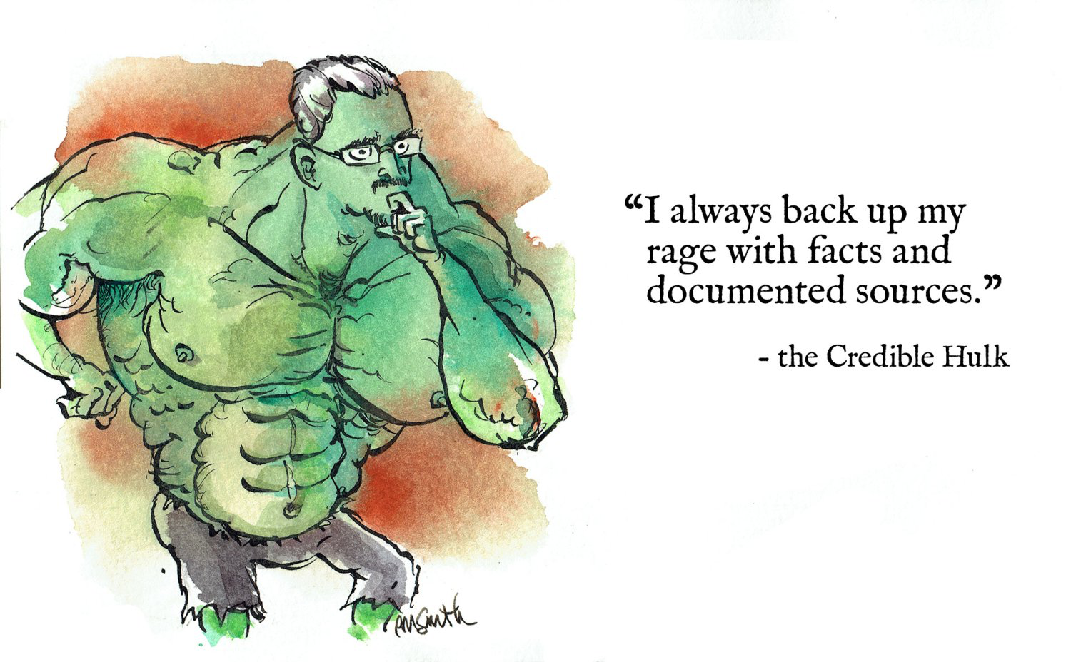
What should we cite?
Credible Hulk by Eric M. Smith

Slide 7
Parts of a Citation
In-text Citation
Full Reference
Goes immediately after the reference
Provides limited information i.e. author, year, page number
Contained in parenthetical references e.g. (Hennig 2018)
Goes on a separate page with a subheading
Provides the full publication details
Could include link or DOI number
Must provide all the necessary details to be able to find the source material

Slide 8
APA In-text
Always include author and year in parenthesis unless you use the author’s name in your phrase
Separate the two with a comma
Specific references (direct quotation and paraphrase) require page numbers for print sources
  Use p. for one page, and pp. for multiple pages
According to Hennig (2018), digital coupons shape customer habits
CBC quotes Chris Emergui that “digital marketing plays a bigger role than ever before” (Hennig, 2018)

Slide 9
Signal Phrase
Use a signal phrase to introduce or lead into a reference
Signals that the idea comes from another source
e.g. Furthermore, Hennig (2018) adds that coupons have changed from a print to a digital marketing strategy.
Some Signal Phrases to use: adds, admits, agrees, argues, claims, comments, compares, demonstrates, illustrates, implies, insists, notes, reasons, says, states, suggests

Slide 10
Practice In-Text Citation By Hand
Please provide a correct in-text citation for the sources you brought in today.
If you did NOT bring in a source, please practice using this source:
  Author: Clare Hennig
  Title: Grocery stores cashing in on digital trends to attract shoppers
  Website Name: CBC News
  Date of Publication: 04/24/2018
  URL: https://www.cbc.ca/news/canada/british-columbia/grocery-stores-turn-digital-to-attract-shoppers-1.4633031

Slide 11
APA References Page
Centre the word References at the top of the page
Alphabetize works by last name
Use a hanging indent for each citation
Last name, first initial for all authors
Capitalize first word, first word after a colon, proper nouns and acronyms

Slide 12
APA References Structure
Print Book
Last name, first initial. (Date). Title of Book. City of Publication: Publisher.
Online Article
Last name, first initial. (Date). Title of Article. Title of Journal, Volume Number(Issue), Pages numbers. Retrieved from: <link>.

Slide 13
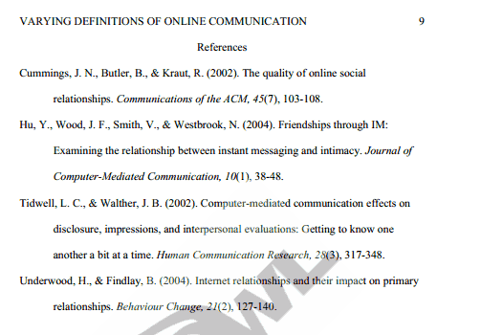
APA Sample References

Slide 14
Practice Reference List By Hand
Please provide a correct reference list for the sources you brought in today.
If you did NOT bring in a source, please practice using this source:
  Author: Clare Hennig
  Title: Grocery stores cashing in on digital trends to attract shoppers
  Website Name: CBC News
  Date of Publication: 04/24/2018
  URL: https://www.cbc.ca/news/canada/british-columbia/grocery-stores-turn-digital-to-attract-shoppers-1.4633031

Slide 15
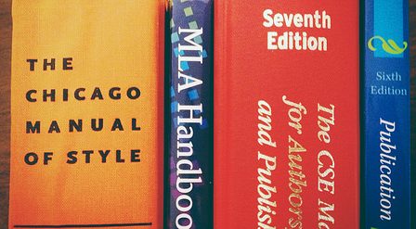
Reminder: Quick Guides Are Available
Visit the SMU Library Website!
https://smu.ca/academics/citations-refworks.html
Humboldt library

Slide 16

One More Resource
https://owl.english.purdue.edu/owl/section/2/10

Slide 17
Paraphrase Process
Read the original passage as many times as you need to in order to understand it thoroughly.
Set it aside and write your paraphrase.
Check your paraphrase against the original to make sure you have accurately expressed the original’s meaning.
Use quotation marks for any term or phrase you have borrowed.
Record the source (author, title, page) for future use.
Keep notes about to how you expect to use this paraphrase.
Paraphrase

Slide 18
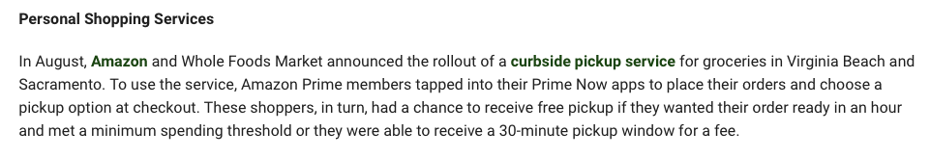
What is wrong with this paraphrase?
Original
Incorrect Paraphrase
Personal shopping services including curbside pickup are being used by Amazon and Whole Foods. Customers tapped into their ordering app to place their order and choose a pickup option. Customers would get free pickup if they wanted their order ready in an hour and met a minimum spending amount.
Reference
PYMNTS (2018, Dec 28). 2018 Recap: The Year in Grocery Innovations.
  PYMNTS. Retrieved from: https://www.pymnts.com/news/retail/2018/grocery-innovations-cashierless-checkout-curbside-pickup

Slide 19
Pair and share. Review your partner’s paraphrase. Compare it against the original. Discuss the similarities and difference in what you included.

Slide 20
How should you organize your assignment? Write out a numbered list of the parts.
These are the instructions:
After your introduction, logically organize the body of the report to identify and discuss each of your trends or innovations. Recommend the best one to introduce to Harvest Grocery. Conclude your report by summarizing your research, and highlighting the most relevant information for your reader.

Slide 21
Headings
Highlight major ideas
Allow the reader to see the big picture quickly
Break up long sections of text

Slide 22
Subheadings
Talking
Descriptive
Provide more information about the content
Spark reader interest
May not show how the report is organized
Show outline without providing insight into the content
Reduce opposition by remaining general
May not show specifics

Slide 23
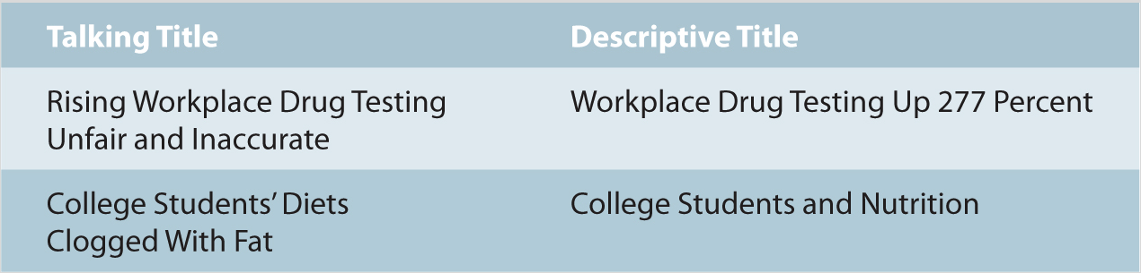
What is the difference between these titles?

Slide 24
Brainstorm some talking headings for these sections.
Trend 1: Instacart
Trend 2: Self Checkout
Trend 3: No Waste
Recommendations
Summary

Slide 25
Heading Parallelism
Benefits of Instacart
Why Self Checkouts are Bad for Customers
Advantages of Personal Shopping Apps
Disadvantages of Self-Checkout Services

Slide 26
Fix the parallelism in the headings by putting them into the same structure.
Use a present tense verb (e.g. Upgrade, Adopt)
Use an –ing word (e.g. Upgrading, Adopting)
Use a question format (e.g. Why should you…)

Slide 27
Please submit your APA Homework.

Slide 28
For Thursday
Reports: Structuring your Report
Read: Chapter 5: 118-119
Coursepack: 8-9
Appendix B: 5-8
Review: APA Formatting Guidelines
Write: Revise APA and write report draft

